Slide 1
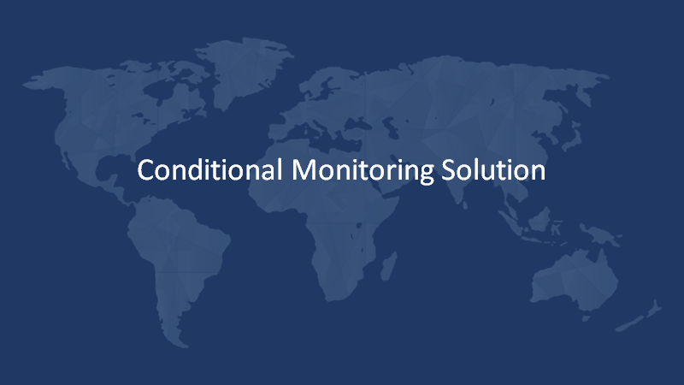

Slide 2
IOT Architecture
Application Layer
DASHBOARD
Processing Layer
STORE AND ANALYSIS DATA. CLOUD COMPUTING
Aggregation Layer
SERVER SOCKET APPLICATION
Transport Layer
TCP/IP
Device Layer
IOT Devices

Slide 3
Standard Version
Gateway | 1
Max Device with One Gateway | 15
Raw data packet size | 13 byte
Temperature Stream interval (std) | 15 min
Humidity Stream interval (std) | 15 min
Device / Day (Temperature Stream Data 15 minute interval) | 96 records
Device/ Day (Humidity Stream Data 15 minute interval) | 96 records
Temperature Data Gateway/Day(15 device) | 1440 records
Humidity Data Gateway/Day(15 device) | 1440 records
Gateway Alive Ping alert every minute | 1440 {Updating last alive time in gateway table)
Total Packet sending from Gateway /Day | 4320 Packets(56160 byte)
Advanced version
Gateway | 1
Max Device with One Gateway | 15
Raw data packet size | 13 byte
Temperature Stream interval (adv) | 5 min
Humidity Stream interval (adv) | 5 min
Device / Day (Temperature Stream Data 5 minute interval) | 288 records
Device/ Day (Humidity Stream Data 5 minute interval) | 288 records
Temperature Data Gateway/Day(15 device) | 4320 records
Humidity Data Gateway/Day(15 device) | 4320 records
Gateway Alive Ping alert every minute | 1440 {Updating last alive time in gateway table)
Total Packet sending from Gateway/Day | 10080 Packets(131,040 byte)

Slide 4
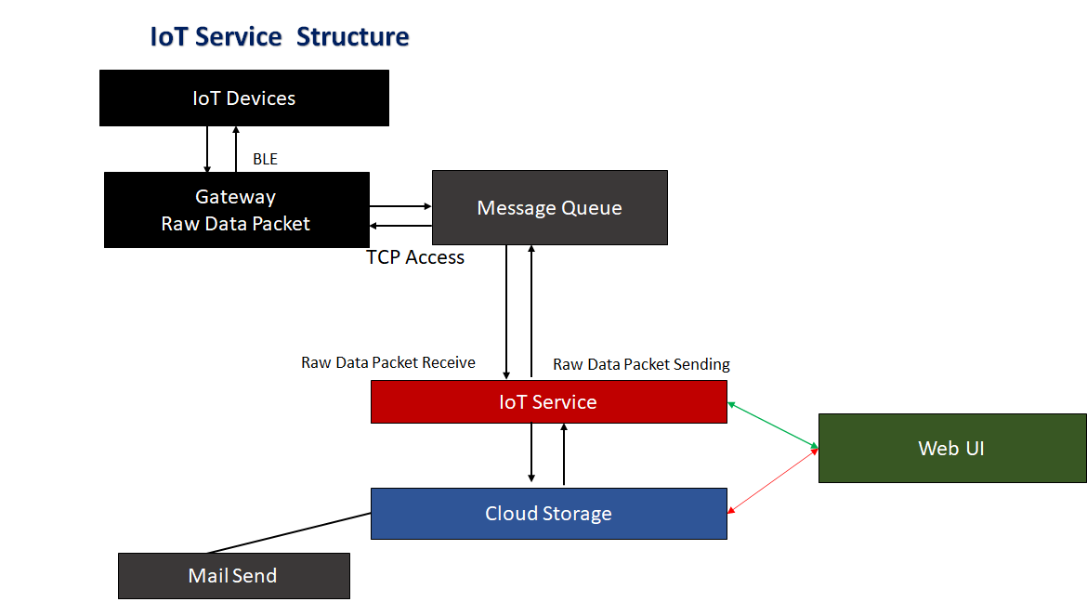

Slide 5
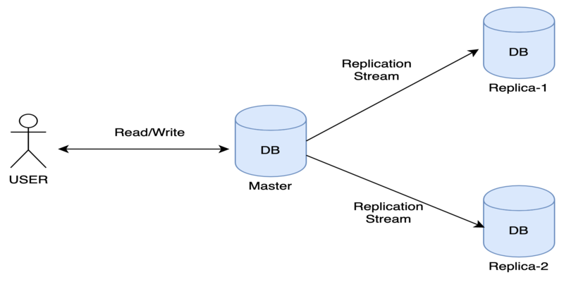
Database Replication

